Slide 1

PhonePe Data Analysis Using Power BI
Interactive Dashboard & Business Insights

Slide 2


INTRODUCTION
The Digital Payments Revolution in India
India has witnessed an unprecedented surge in digital payment adoption, transforming from a cash-dominant economy to one of the world's fastest-growing digital payment markets. With over 10 billion monthly transactions, the landscape has fundamentally shifted how consumers and businesses interact financially.
PhonePe has emerged as a frontrunner in this revolution, commanding significant market share among Unified Payments Interface (UPI) platforms. The platform processes billions of transactions monthly, spanning recharges, bill payments, insurance, loans, and money transfers.
Data analytics has become mission-critical in this ecosystem. Understanding transaction patterns, identifying failure points, and optimizing service delivery can mean the difference between customer retention and churn in an increasingly competitive marketplace.

Slide 3
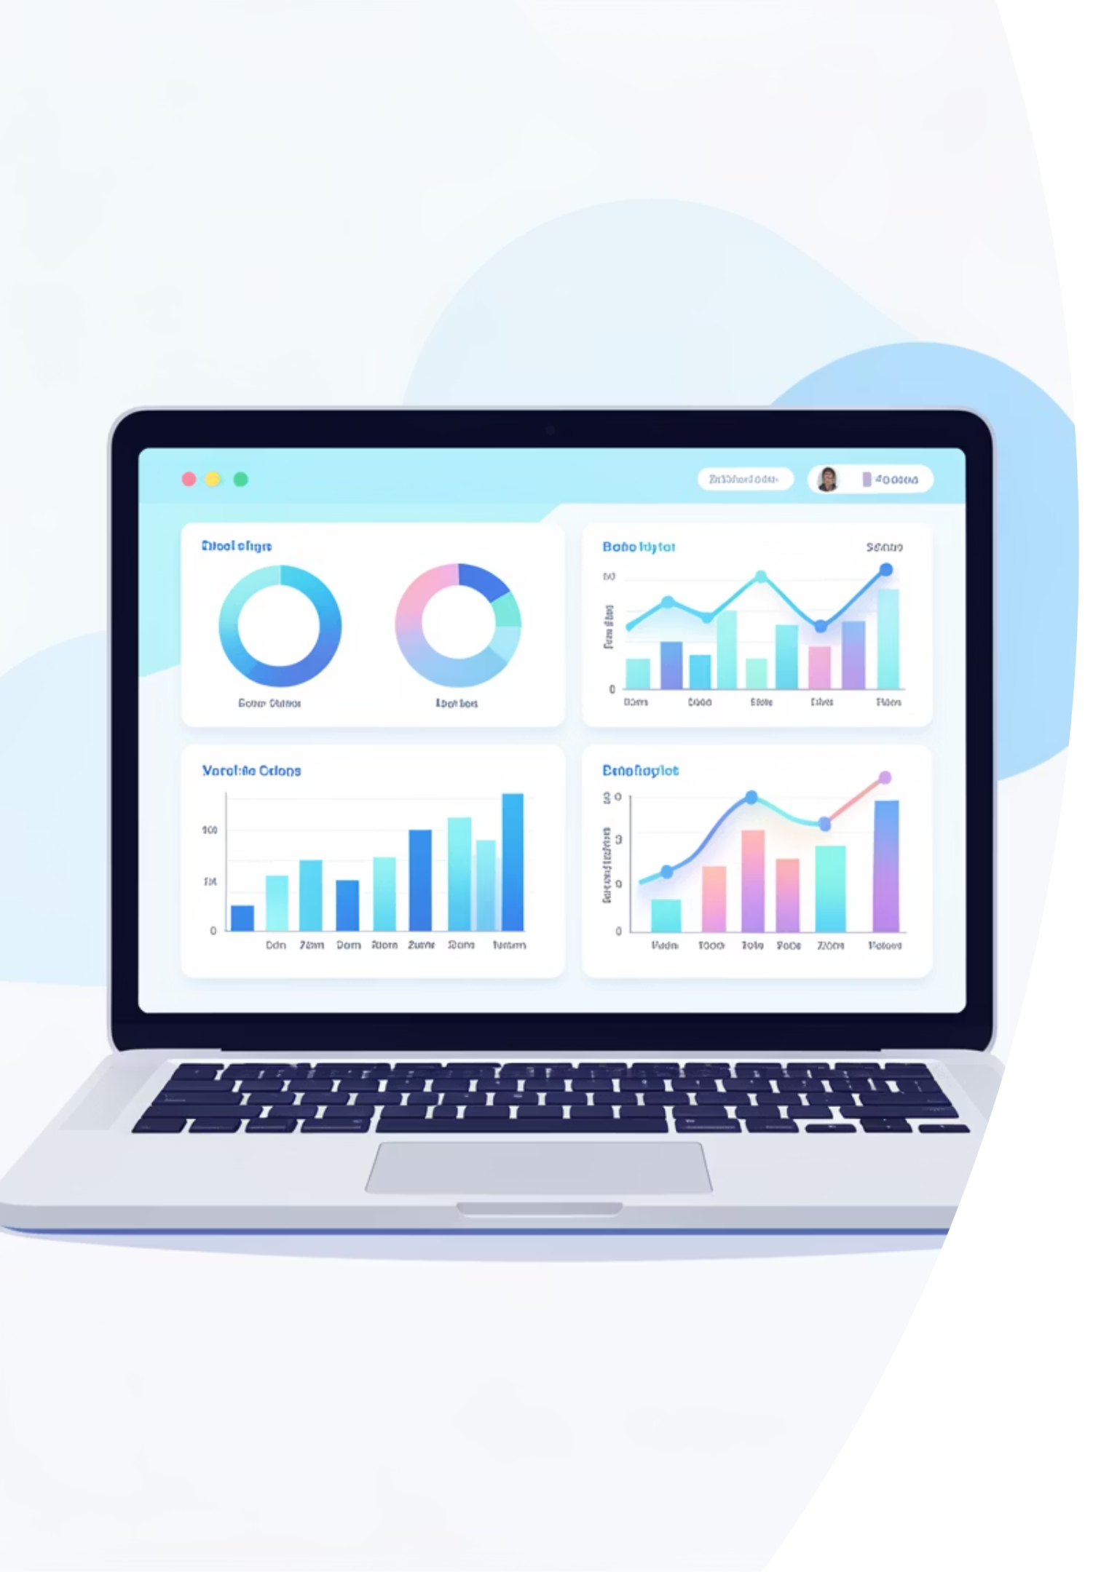
CHALLENGE
Problem Statement
Data Volume Complexity
Transaction Failure Tracking
PhonePe processes millions of transactions daily across multiple service categories. Manual analysis of this massive dataset is impractical and error-prone, creating blind spots in business intelligence.
Failed payments directly impact revenue and customer satisfaction. Without systematic tracking, identifying patterns in payment failures and their root causes remains challenging.
Decision-Making Gaps
Business stakeholders need real-time, actionable insights to make informed decisions. Traditional reporting methods lack the interactivity and visual clarity required for strategic planning.

Slide 4
Project Objectives
This analysis aims to transform raw transaction data into actionable business intelligence through comprehensive Power BI visualization and analysis.
01
02
Comprehensive Transaction Analysis
Financial Performance Tracking
Examine PhonePe transactions across all service categories including insurance, loans, recharges, bill payments, and money transfers to identify usage patterns and trends.
Monitor transaction volumes and amounts across services to understand revenue streams and identify high-performing categories.
03
04
Failure Pattern Identification
Interactive Dashboard Development
Systematically analyze failed transactions to uncover common failure reasons, peak failure times, and service-specific issues affecting success rates.
Build a user-friendly, interactive Power BI dashboard enabling stakeholders to explore data dynamically and extract insights independently.

Slide 5
DATA FOUNDATION
Dataset Overview
Transaction-Level Data Structure
Service Categories Covered
The dataset comprises granular transaction records capturing every payment attempt on the PhonePe platform. Each record provides a comprehensive view of transaction characteristics, enabling deep analytical insights.
Insurance Payments
Premium payments and policy transactions
Core Data Fields
Loan Disbursements
Transaction ID: Unique identifier for tracking individual payments
Personal and business loan transactions
Transaction Amount: Monetary value in Indian Rupees
Transaction Date & Time: Temporal information for trend analysis
Payment Status: Success or failure classification
Mobile Recharges
Service Type: Category classification (insurance, loans, etc.)
Prepaid and postpaid top-ups
Failure Reason: Detailed error codes and descriptions
Bill Payments
Utility, credit card, and service bills
Money Transfers
Peer-to-peer and merchant payments

Slide 6
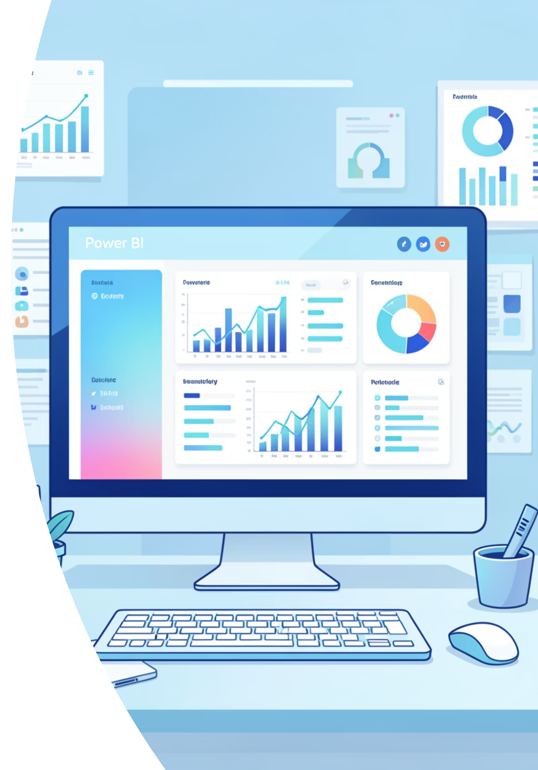





Tools & Data Preparation
Power BI Desktop
Primary visualization and analytics platform for creating interactive dashboards with advanced DAX calculations and custom visualizations.
Data Sources
Excel and CSV datasets containing transaction records, imported and transformed using Power Query for optimal performance.
Data Cleaning
Validation, duplicate removal, null handling, and standardization of date formats and categorical variables for analytical accuracy.
Service Filtering
Implementation of slicers and filters enabling dynamic service-wise analysis and cross-category comparisons.
Technical Note: Data preparation consumed approximately 30% of project time, ensuring dashboard reliability and performance optimization through proper data modeling and relationship establishment.

Slide 7

DASHBOARD DESIGN
Interactive Dashboard Architecture
The Power BI dashboard consists of five interconnected pages, each designed with consistent branding and intuitive navigation. The purple and white color scheme reflects PhonePe's brand identity while maintaining professional readability.
1
Home Summary
Design Principles
Consistent Layout: Uniform header, navigation, and KPI placement across all pages
2
Brand Alignment: PhonePe-inspired purple palette with strategic white space
Interactive Elements: Navigation buttons, date slicers, and service filters on every page
Failed Transactions
Visual Hierarchy: Key metrics prominently displayed with supporting details below
3
Responsive Design: Optimized for both desktop viewing and presentation mode
Insurance Analysis
4
Loans & Recharges
5
Money Transfers

Slide 8
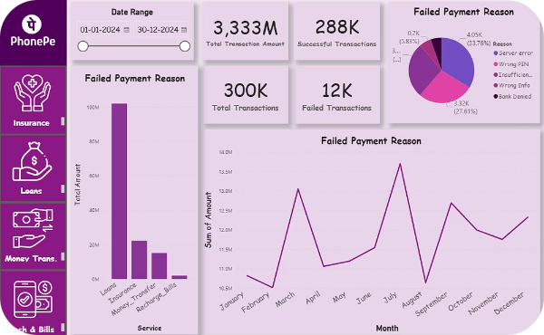
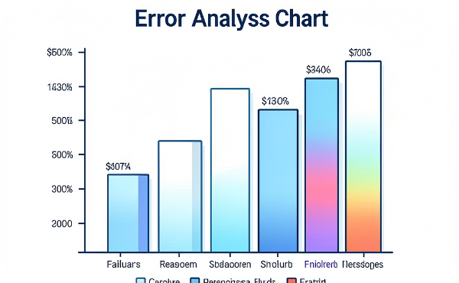
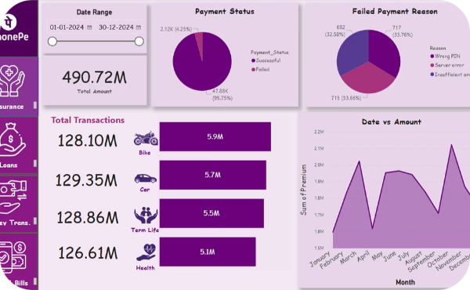
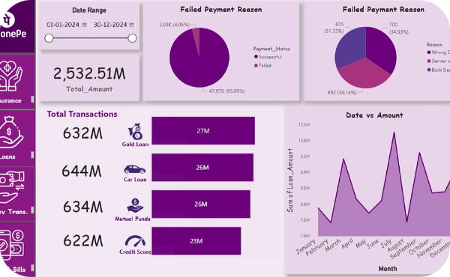
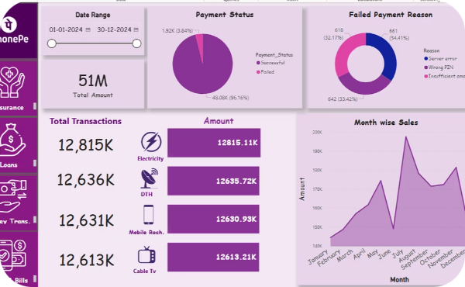
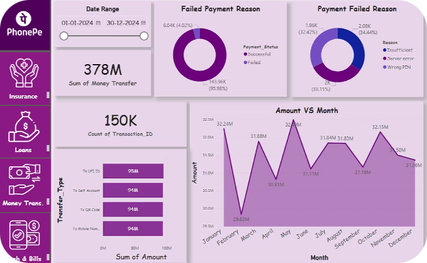
Key Analysis Pages
Home Page Summary
Failed Transactions Deep Dive
Insurance Transactions
Loans Analysis
Executive overview displaying total transactions, aggregate transaction amounts, success rates, and failure percentages. Includes trend visualizations and period-over-period comparisons for quick performance assessment.
Comprehensive analysis of payment failures categorized by reason codes: insufficient balance, technical errors, bank declines, and timeout issues. Temporal patterns reveal peak failure times and service-specific vulnerabilities.
Dedicated page examining insurance premium payments, analyzing transaction volumes by policy type, average premium amounts, success rates, and seasonal payment patterns throughout the year.
Loan transaction patterns showing disbursement amounts, approval rates, and repayment schedules. Identifies peak borrowing periods and average loan sizes across categories.
Recharges & Bills
Money Transfers
High-frequency transaction analysis covering mobile recharges and utility bill payments. Tracks popular recharge denominations and bill payment categories with time-of-day transaction patterns.
Peer-to-peer and merchant payment analysis revealing transaction velocity, average transfer amounts, and user engagement patterns across different transfer types and recipient categories.

Slide 9

BUSINESS INTELLIGENCE
Key Insights & Business Value
The dashboard transforms raw data into strategic insights, enabling data-driven decision-making across product, operations, and customer experience teams.
High-Performing Services
Failure Pattern Recognition
Strategic Recommendations
Money transfers and mobile recharges dominate transaction volumes, representing 65% of total payments. These categories show consistently high success rates above 94%, indicating strong technical infrastructure.
The top three failure reasons account for 78% of all failed transactions: insufficient balance (42%), technical timeouts (21%), and bank server issues (15%). Weekend afternoons show 23% higher failure rates.
Data reveals opportunities for balance reminder notifications, infrastructure scaling during peak hours, and enhanced bank integration protocols. Implementing these could reduce failures by an estimated 30%.
Measurable Business Impact
Reduced analysis time from days to minutes through dashboard automation
Enabled real-time monitoring of critical payment metrics
Identified ₹2.3M in recoverable failed transactions monthly
Supported product team prioritization with data-backed insights

Slide 10





Conclusion & Learning Outcomes
Project Achievement Summary
This end-to-end Power BI project demonstrates comprehensive data analytics capabilities, from raw data processing through interactive dashboard deployment. The PhonePe transaction analysis showcases technical proficiency and business acumen equally valued by recruiters and evaluators.
Technical Mastery
Analytical Thinking
Advanced Power BI skills including DAX calculations, data modeling, and custom visualizations
Ability to extract meaningful insights from complex datasets and identify actionable patterns
Business Context
Visual Communication
Understanding of fintech operations and translation of data findings into business value
Effective data storytelling through intuitive dashboard design and clear visual hierarchy
5
100K+
5
Dashboard Pages
Transactions Analyzed
Service Categories
Comprehensive multi-page analysis
Large-scale data processing
Cross-functional insights
"This portfolio project demonstrates the complete analytics workflow that employers seek: data acquisition, cleaning, analysis, visualization, and insight generation. It positions the candidate as ready for data analyst roles in fintech, consulting, or business intelligence."

